Slide 1

RUMOR MILL: TRACKING VIRAL RUMOURS THROUGH TEXTUAL ANALYSIS
BY
M.SRIMANJUNADH
S.SIVANATHAN

Slide 2

INTRODUCTION
The spread of fake news is a growing concern in today's digital age.
Fake news can lead to misinformation, public panic, and erosion of trust.
Distinguishing between real and fake news is a challenging task that requires effective detection tools.
Our project utilizes Natural Language Processing (NLP) techniques to detect fake news.
We have developed a user-friendly Streamlit app that analyzes news articles and predicts their authenticity in real-time.

Slide 3
OBJECTIVE
IDENTIFY FAKE RUMORS: Develop algorithms to accurately detect fake rumors in online textual content.
ANALYZE PATTERNS: Examine linguistic and contextual patterns that distinguish fake rumors from genuine information.
REAL-TIME DETECTION: Implement a system for real-time analysis and flagging of suspicious content on digital platforms.
USER AWARENESS: Provide tools to help users easily identify and avoid spreading false information.
CONTRIBUTE TO RESEARCH: Enhance the understanding of fake news dynamics and contribute to ongoing research in misinformation detection.

Slide 4

MODULES
MODULE 1: IMPORT NECESSARY PACKAGES
STREAMLIT: For creating an interactive web application.
NUMPY: For efficient numerical computations.
PANDAS: For robust data manipulation and analysis.
SCIKIT-LEARN: For implementing machine learning models.
TENSORFLOW: For deep learning functionalities.
WARNINGS: For suppressing unnecessary warnings.

Slide 5

MODULE 2: LOAD THE DATASET
- Dataset contains fake and real news articles.
- Loaded from a CSV file for ease of use.
- Labels converted to binary format (0 for real, 1 for fake) for binary classification.
- Ensures consistent data format for model training.
MODULE 3: SELECT VECTORIZER AND CLASSIFIER
Allows users to select a vectorizer (TF-IDF or Bag of Words) and a classifier (Linear SVM or Naive Bayes) via the sidebar.

Slide 6

MODULE 4: TRAIN THE MODEL
Training the selected classifier using chosen vectorizer.
Model is trained on the preprocessed dataset.
Caching the trained model to speed up predictions.
Evaluation metrics: accuracy, precision, recall, and F1-score to assess performance.
STEPS INVOLVED IN TRAINING:
Data preprocessing.
Vectorization of text data.
Splitting data into training and test sets.
Training the model.
Importance of evaluation metrics.
Model validation and testing.

Slide 7

COLLECTION OF DATASET
The dataset was sourced from Kaggle, focuses on identifying real and fake news through textual analysis. It contains four key columns that provide essential information for our analysis.
COLUMNS IN A DATASET:
NUMBER:
Description: A unique identifier assigned to each news article.
Purpose: Helps in tracking and managing individual entries in the dataset.
TITLE:
Description: The headline or title of the news article.
Purpose: Provides a concise summary of the article's content, useful for initial classification.
TEXT:
Description: The main body of the news article.
Purpose: Contains detailed content used for in-depth textual analysis to determine the authenticity of the news.

Slide 8
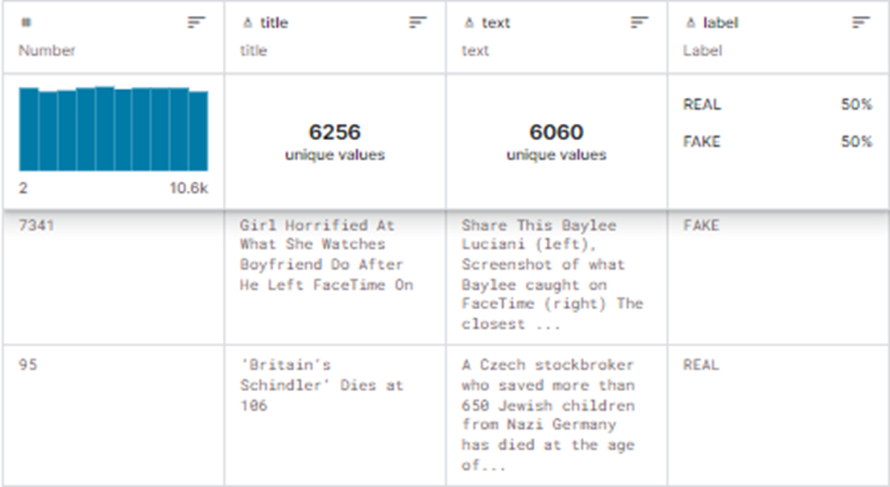
LABEL:
Description: Indicates whether the news is real (1) or fake (0).
Purpose: Serves as the target variable for training and evaluating machine learning models.
FILE NAME: Fake-or-real-news.csv
Dataset source: https://www.kaggle.com/datasets/jillanisofttech/fake-or-real-news

Slide 9

NLP
What is NLP?
NLP, or Natural Language Processing, is a branch of artificial intelligence that focuses on enabling computers to understand, interpret, and generate human language. In simpler terms, it's about teaching machines to understand the way humans speak and write.
In our project, we're using NLP to analyze and process large amounts of text data. This helps us extract valuable insights, automate tasks like sentiment analysis or language translation, and even build chatbots that can communicate with users in a human-like manner. Essentially, NLP empowers us to harness the power of language to make our project more efficient, intelligent, and user-friendly.

Slide 10
NLP AND ITS TYPES USED
TEXT CLASSIFICATION: We use NLP algorithms to classify text as either fake or real news. This helps in automatically identifying suspicious content.
SENTIMENT ANALYSIS: By analyzing the emotions and opinions expressed in the text, we can detect if a message is intended to provoke fear, anger, or other strong reactions, which are often associated with fake rumors.
NAMED ENTITY RECOGNITION (NER): NLP helps in identifying and categorizing names of people, organizations, and places mentioned in the text. This is useful for verifying the credibility of the information.

Slide 11

Cont.
TOPIC MODELING: This technique allows us to uncover the main topics discussed in a collection of texts, helping us understand common themes in fake rumors.
LANGUAGE MODELING: By analyzing the likelihood of word sequences, we can spot unusual language patterns typical of fake news.
Using these NLP methods, our project aims to create a robust system for detecting and mitigating the spread of fake rumors online.

Slide 12

CLASSIFIER
What is a Classifier?
A classifier is like a digital detective that sorts data into different categories based on patterns it learns from examples. In our project, classifiers are essential tools used to distinguish between fake and genuine rumors in textual content.
Why We Use Classifiers
We use classifiers because they help us automate the process of identifying fake rumors. By analyzing patterns and features in text data, classifiers can quickly determine whether a piece of information is likely to be true or false. This is crucial for combating the spread of misinformation online.

Slide 13
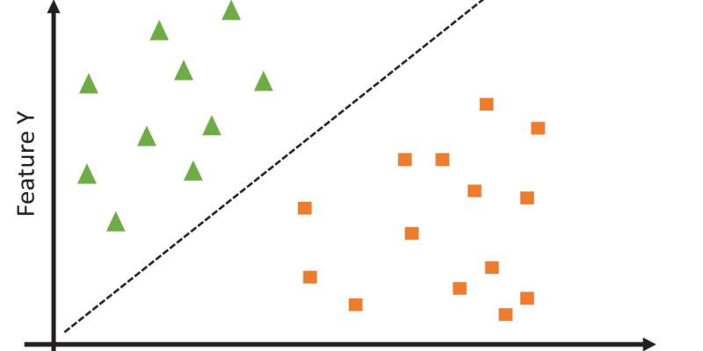
SUPPORT VECTOR CLASSIFIER
Support Vector Machines (SVM) are like boundary builders. They find the best possible line (or hyperplane) to separate different classes of data. In our project, SVMs are used to create a clear boundary between fake and genuine rumors based on various textual features. They're powerful because they can handle complex data and find the most optimal decision boundary.

Slide 14
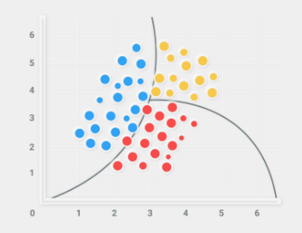
NAIVE BAYES CLASSIFIER
The Naive Bayes classifier is like a simple, but surprisingly effective, detective. It calculates the probability of a text belonging to a particular category (e.g., fake or genuine) based on the presence of certain words or features. Despite its simplicity, it's known for its speed and efficiency, making it a popular choice for text classification tasks like ours.

Slide 15

VECTORIZER
What is a Vectorizer?
A vectorizer is a tool that transforms text data into numerical data that computers can understand and analyze. It converts words and phrases into vectors (arrays of numbers) which can then be used by machine learning algorithms to classify and analyze the text.
Why We Use Vectorizer
We use vectorizers in our project because machine learning models, like classifiers, require numerical input to process data. Text data in its raw form is just a sequence of characters, which machine learning algorithms can't directly work with. By converting text into vectors, we enable our classifiers to effectively analyze and differentiate between fake and genuine rumors.

Slide 16

BAG OF WORDS
Bag of Words (BoW) is a simple and commonly used method for text representation in natural language processing. It transforms text into numerical features that machine learning models can use. In the BoW model, a text is represented as an unordered collection of words, ignoring grammar and word order but keeping track of the frequency of each word.
TEXT PREPROCESSING: The text is cleaned (removing punctuation, converting to lowercase, etc.).
VOCABULARY CREATION: A list (vocabulary) of all unique words in the text corpus is created.
VECTORIZATION: Each text is represented as a vector indicating the frequency of each word in the vocabulary.
Output will show the vocabulary and how each text is represented as a vector based on word frequency, which can then be used for machine learning tasks such as rumour detection.

Slide 17
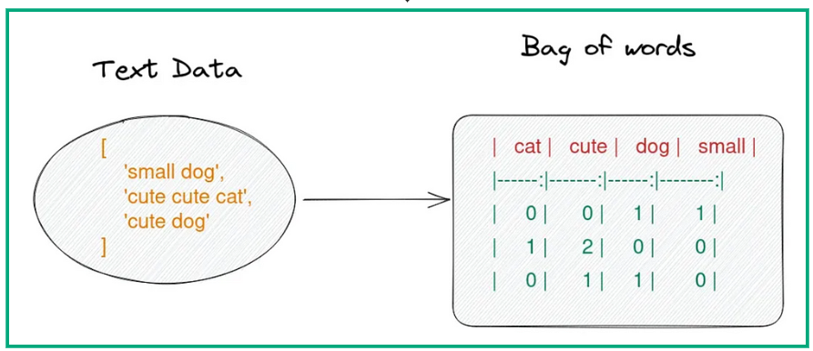

Slide 18

TF-IDF Vectorizer
The Term Frequency-Inverse Document Frequency (TF-IDF) Vectorizer improves upon the Count Vectorizer by considering the importance of words across multiple documents. It calculates the frequency of a word in a document relative to its frequency in the entire dataset. This way, common words that appear frequently in many documents are down-weighted, while rare but important words are given more significance.
Why We Use TF-IDF Vectorizer
In our project, we use the TF-IDF vectorizer because it provides a more nuanced representation of text data. By highlighting important words and downplaying common but less informative ones, TF-IDF helps our classifiers better identify patterns and features that distinguish fake rumors from genuine ones.

Slide 19
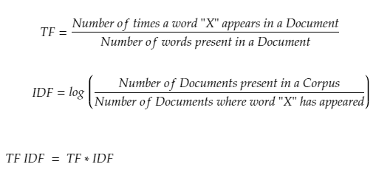

Slide 20

STREAMLIT
Streamlit is an open-source Python library used to create interactive, web-based applications for data science and machine learning projects. It allows you to build custom web apps quickly and easily, using just a few lines of Python code.
We use Streamlit in our project to create an interactive and user-friendly interface for visualizing and analyzing fake rumors. It helps us present our results in a clear and accessible way, making it easier for users to interact with our model and understand its findings.
1. DATA VISUALIZATION: Streamlit allows us to create dynamic visualizations of our data and model results. Users can interact with these visualizations to explore patterns and insights in the data.

Slide 21
2. USER INTERACTION: We can add interactive widgets to our app, enabling users to input text, select parameters, and run analyses on the fly. For example, users can input a news article and get an immediate analysis of whether it's likely to be fake or genuine.
3. REAL-TIME FEEDBACK: As users interact with the app, Streamlit provides real-time feedback, displaying results and visualizations instantly. This enhances the user experience and makes our tool more responsive and informative.
Sets page configuration including title, icon, and layout.
Displays the title and a PNG image for visualization.
Hides the Streamlit style for a cleaner interface.
Provides a text area for users to input news articles.
Upon clicking the "Check" button, predicts the authenticity of the input news article using the trained model and displays the result.

Slide 22

PERFORMANCE METRICS
Performance metrics is a set of metrics used to evaluate the effectiveness and accuracy of a machine learning model. It helps us understand how well our model is performing in classifying data correctly.
Why do we consider performance metrics?
We use a performance metrices in our project to ensure that our model accurately identifies fake and genuine rumors. By analyzing these metrics, we can determine the strengths and weaknesses of our model and make necessary adjustments to improve its performance.
Key Performance Metrices:
ACCURACY
PRECISION
RECALL(SENSITIVITY)
F1 SCORE

Slide 23
PERFORMANCE METRICS
1. *Evaluating Model Accuracy*: We calculate accuracy to understand how often our model makes correct predictions overall.
2. *Analyzing Precision and Recall*: By examining precision and recall, we can see how well our model balances between identifying true positives and avoiding false positives.
3. *Balancing Metrics with the F1 Score*: The F1 score helps us ensure that our model maintains a good balance between precision and recall, which is particularly important in identifying fake rumors accurately.
4. *Visualizing Results with the Confusion Matrix*: The confusion matrix provides a detailed view of the model’s performance, showing where it correctly or incorrectly classifies instances. This helps us pinpoint specific areas for improvement.

Slide 24

CONFUSION MATRIX
A confusion matrix is a table used to evaluate the performance of a classification model. It shows the actual versus predicted classifications, helping to understand how well the model is distinguishing between different classes.
We use a confusion matrix in our project to measure the accuracy and effectiveness of our model in detecting fake rumors. It helps us identify how many instances were correctly or incorrectly classified, providing a clear picture of the model's performance.
1. PERFORMANCE EVALUATION: By analyzing the values in the confusion matrix, we can calculate various performance metrics, such as accuracy, precision, recall, and F1 score. These metrics give us insights into how well our model is performing.
2. IDENTIFYING WEAKNESSES: The confusion matrix helps us pinpoint where the model is making mistakes, such as misclassifying genuine rumors as fake or vice versa. This information is crucial for refining and improving the model.
3. BALANCING THE MODEL: If we notice a high number of false positives or false negatives, we can adjust our model or retrain it with more balanced data to improve its performance.

Slide 25
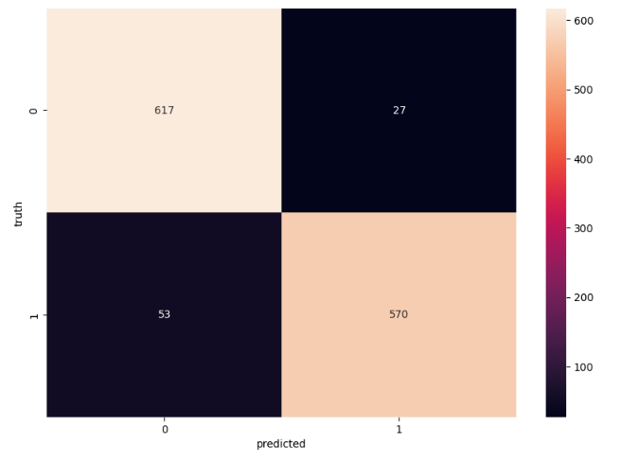
A confusion matrix typically consists of four components:
1. TRUE POSITIVES (TP): The number of correctly predicted fake rumors.
2. TRUE NEGATIVES (TN): The number of correctly predicted genuine rumors.
3. FALSE POSITIVES (FP): The number of genuine rumors incorrectly predicted as fake (also known as Type I errors).
4. FALSE NEGATIVES (FN): The number of fake rumors incorrectly predicted as genuine (also known as Type II errors).

Slide 26

MACHINE LEARNING PIPELINE
A machine learning pipeline is a sequence of steps or processes used to automate the workflow of a machine learning project. It ensures that data flows smoothly from raw input to the final output prediction. A typical pipeline includes steps for data collection, preprocessing, feature extraction, model training, evaluation, and deployment
In our rumour detection project, using a machine learning pipeline ensures:
1. EFFICIENCY: Automates repetitive tasks, saving time and effort.
2. CONSISTENCY: Maintains uniform processes across different stages, improving reliability.
3. SCALABILITY: Easily adjusts to handle larger datasets and more complex models.
4. MAINTAINABILITY: Simplifies debugging and updating the workflow, making the project easier to manage and improve.

Slide 27
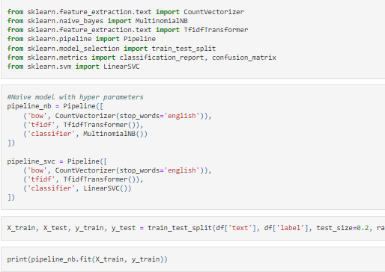
1.TFIDFVECTORIZER: converts text data into numerical TF-IDF features.
2.STANDARDSCALER: normalizes these features (note: with_mean=False is used because sparse matrices from TF-IDF do not support mean subtraction).
3. SVC: trains a Support Vector Machine classifier.
The pipeline automates the flow from raw text data to model training and evaluation, ensuring a smooth and efficient workflow

Slide 28
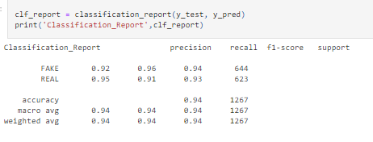
CLASSIFICATION OF SVM MODEL

Slide 29
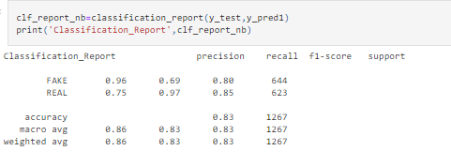
CLASSIFICATION OF NAIVE BAYES MODEL

Slide 30

CONFUSION MATRIX OF SVM MODEL

Slide 31
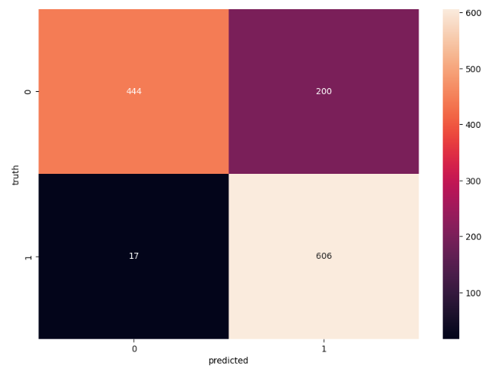
CONFUSION MATRIX OF NAIVE BAYES MODEL

Slide 32
RESULT
0.8255137358444975
CALCULATING PERFORMANCE METRICS OF THE SVM MODEL AND NAÏVE BAYES MODEL
From the confusion matrix, we can derive key metrics:
ACCURACY: (TP + TN) / (TP + TN + FP + FN) - The overall correctness of the model.
PRECISION: TP / (TP + FP) - The accuracy of positive predictions.
RECALL: TP / (TP + FN) - The ability of the model to find all positive instances.
F1 SCORE: 2 * (Precision * Recall) / (Precision + Recall) - The harmonic mean of precision and recall.
RESULT OF SVM MODEL RESULT OF NAIVE BAYES MODEL
ACCURACY:0.9368587213891081 ACCURACY: 0.8287292817679558 PRECISION:0.9375539360859713 PRECISION: 0.8592431382623872 RECALL:0.9368587213891081 RECALL: 0.8287292817679558 F1 SCORE: 0.9368105898907034 FI SCORE: 0.8255137358444975

Slide 33


Slide 34

CONCLUSION
The "Rumor Mill: Tracking Viral Rumors through Textual Analysis" project successfully demonstrates the application of Natural Language Processing and machine learning techniques to differentiate between real and fake news articles. By providing an intuitive Streamlit web application, users can easily input news articles, select preferred vectorization and classification methods, and receive instant predictions about the authenticity of the content.

Slide 35

KEY ACHIEVEMENTS
1. USER-FRIENDLY INTERFACE: The use of Streamlit allows for a simple yet powerful interface where users can interact with the model without requiring any technical background.
2. FLEXIBILITY IN MODEL SELECTION: Users can choose between different vectorization techniques (TF-IDF and Bag of Words) and classifiers (Linear SVM and Naive Bayes), enabling a hands-on understanding of how different methods impact prediction results.
3. REAL-TIME PREDICTION: The application provides real-time feedback, making it a useful tool for journalists, researchers, and the general public to quickly assess the credibility of news articles.
4. EDUCATIONAL VALUE: This project serves as a practical example of applying machine learning to real-world problems, showcasing the power and potential of NLP in combating misinformation.

